Slide 1


Company BB Presentation
CEO - Taya Stewart
Sales Manager - Raymond Delgado
Marketing Manager - Adnan Elahi
PO/M Manager - Adrian Marroquin
Notes:
Title Team Slide (Adrian)

Slide 2

Description of Company and Markets
Company BB is a premier water bottle company geared toward being a low cost supplier for our consumers.
Our value driven model brings affordable options across the country.
The water bottle industry in our country is an oligopoly and the major players are currently controlling the price. However, we want to keep our prices low for our water lovers.
Notes:
Taya

Slide 3
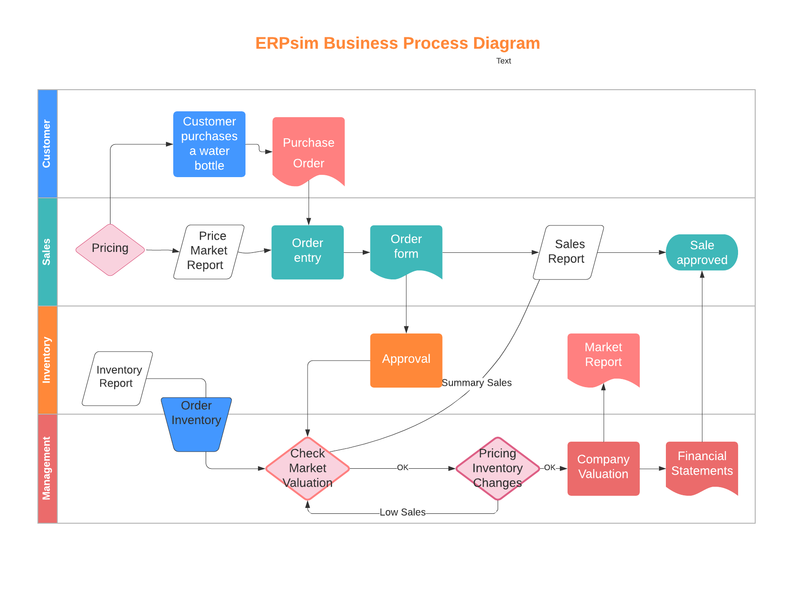
Business Process Diagram
Customer
Sales
Inventory
Management
Notes:
Taya

Slide 4
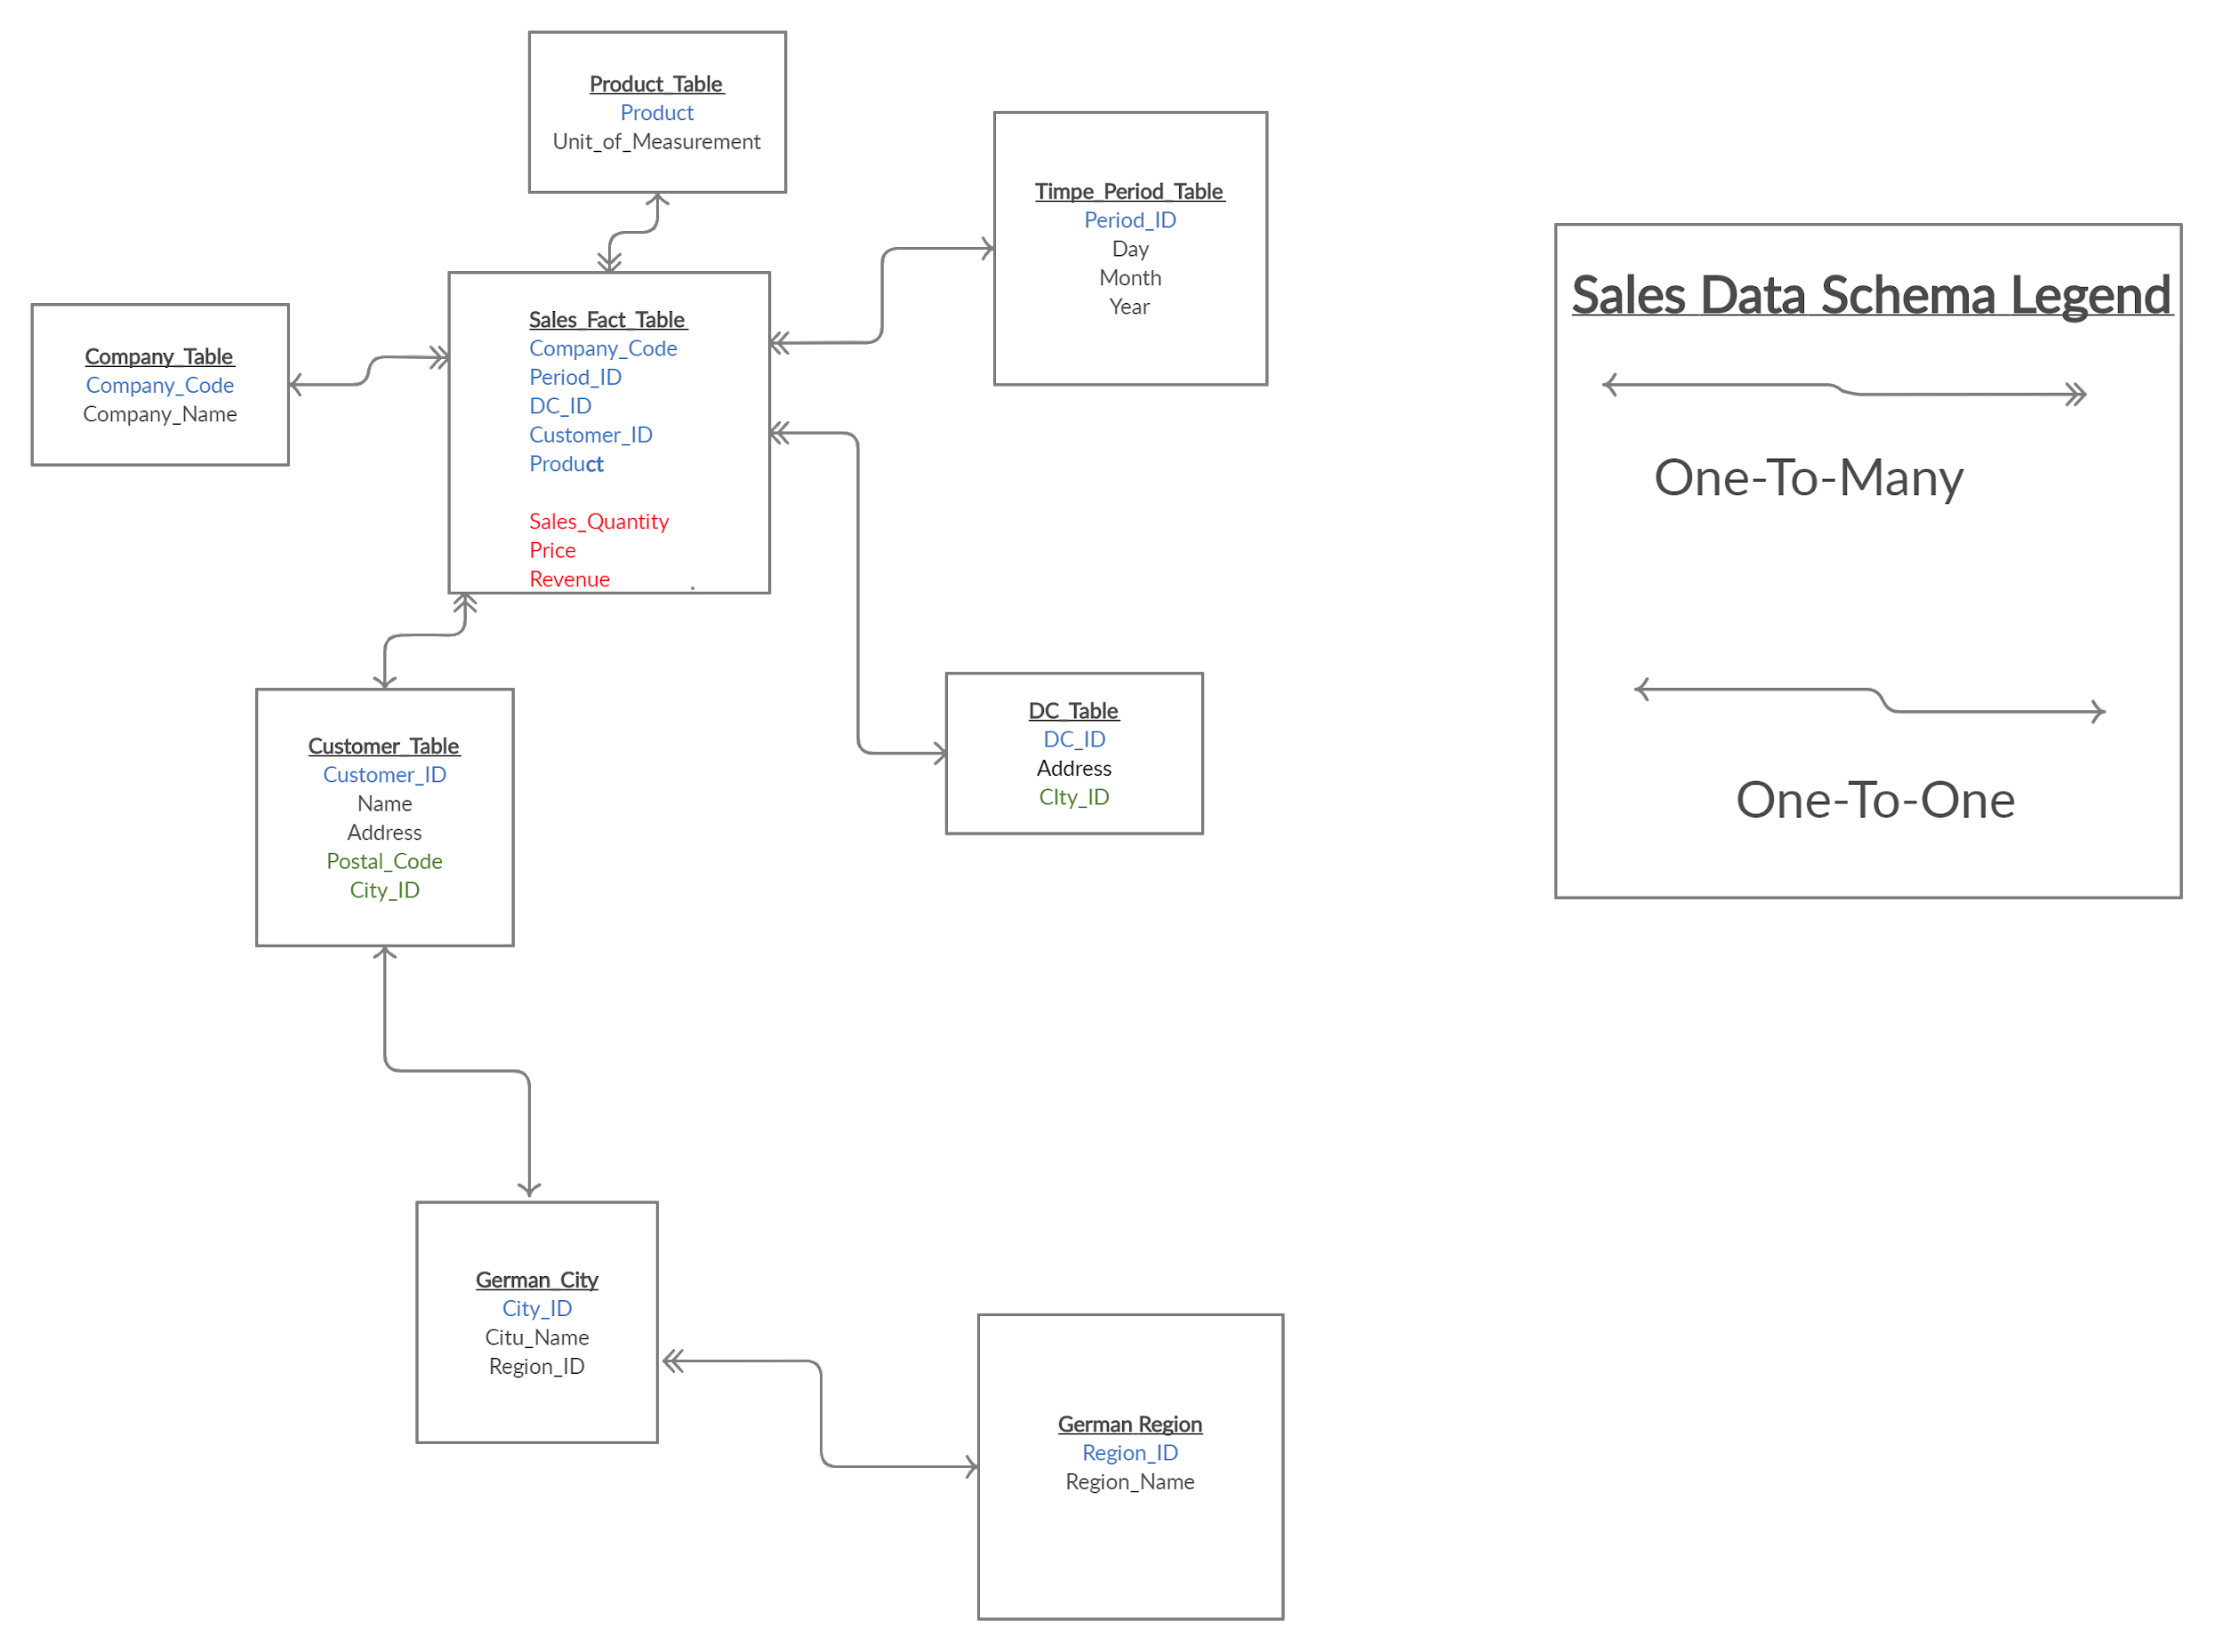
Sales Schema
Sales Fact Table
Time Period Table
Company Table
Product Table
Distribution Center (DC) Table
Customer Table
German City Table
German Region Table

Slide 5
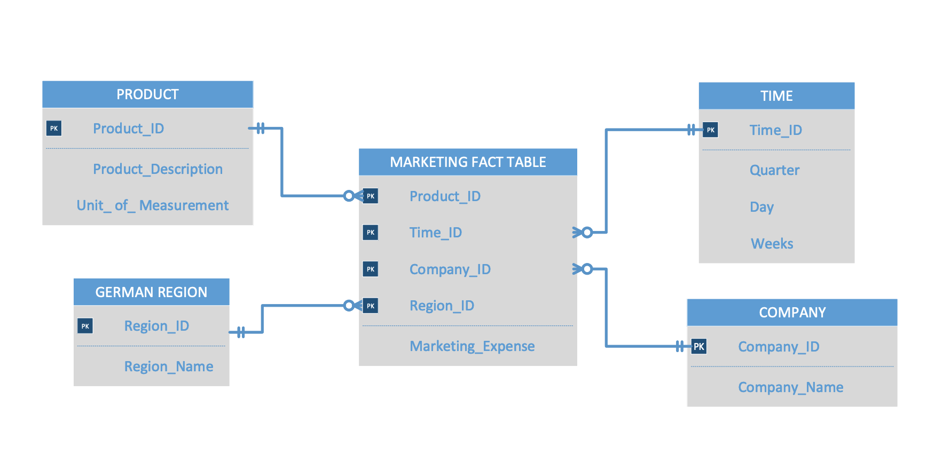
Marketing Schema
Region Table
Product table
Company table
Time Table

Slide 6
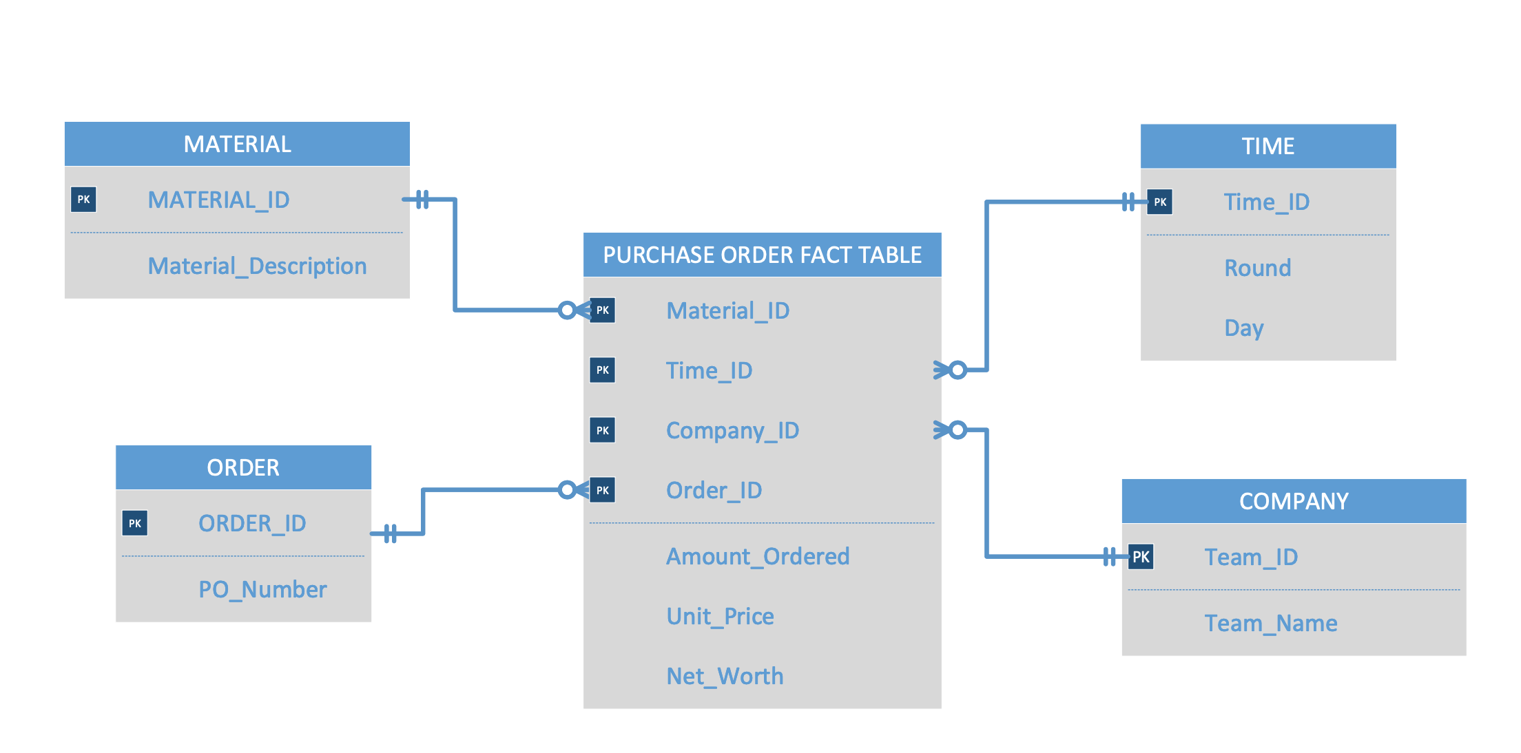
PO/MM Schema
Material Table
Time Table
Sales Organization Table
Order Table
PO Fact Table

Slide 7
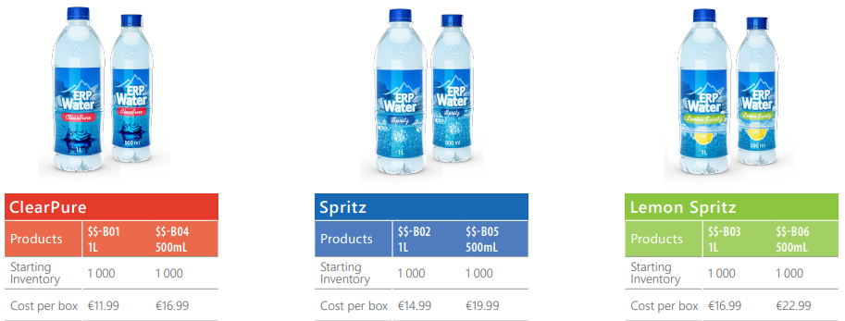
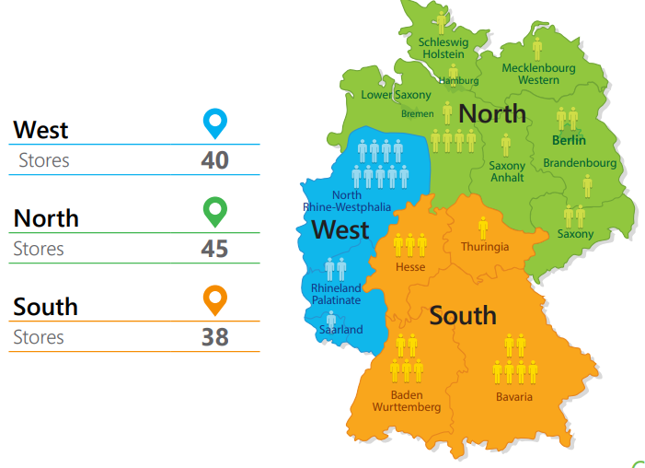
Products & Region
Six Products
1L ClearPure
500mL ClearPure
1L Spritz
500mL Spritz
1L Lemon Spritz
500mL Lemon Spritz
Notes:
PRODUCTS SOLD Adnan

Slide 8

Objectives
Highest Valuation out of 3 teams
Effective Teamwork
Employ Strategy and Adjust
Each Member Assume Role Responsibility

Slide 9
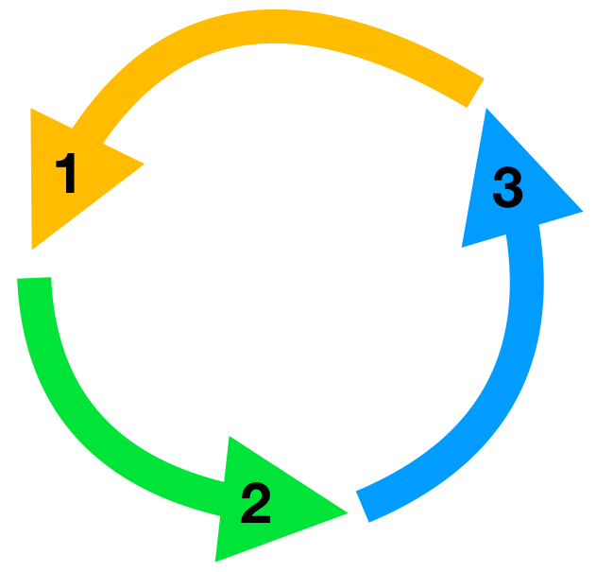
SMART Goals and Business Strategy
Specific
Measurable
Attainable
Relevant
Timely
Strategic Statement:
We want to continue to be the low cost providers in the market. We will increase our profit margins by 15% in our highest performing regions by decreasing marketing cost and increasing price by 5%. In our low performing regions we will reduce the amount of unpopular products on the shelves and increase marketing cost for those up and coming products. We plan to remain true to our original goal to be a low cost alternative while our competitors rise prices substantially. This will be accomplished in the next quarter.
Notes:
Taya

Slide 10
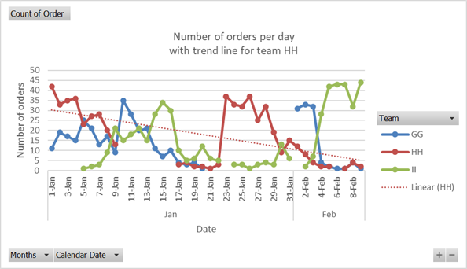
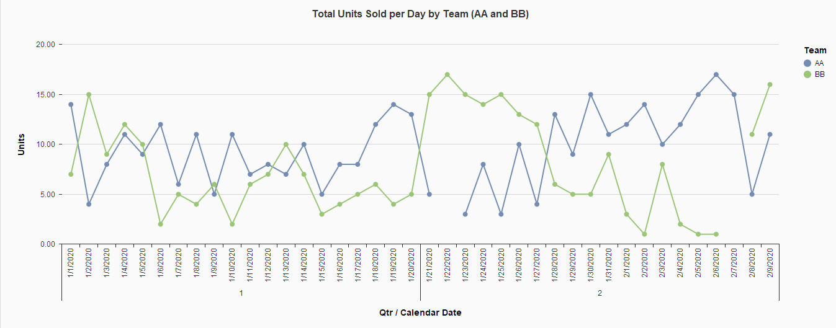
Sales Strategy
Lessons Learned(Practice Round)
Initial Strategy:
Lower Prices
High inventory turnover
Issues:
Inventory failed to keep up with demands
No product to sell!
Final Sales Strategy:
Set prices at premium (raise by $1)
Possible outcomes of strategy:
Lack of sales: Reduce the price
Lack of inventory: Increase the price

Slide 11
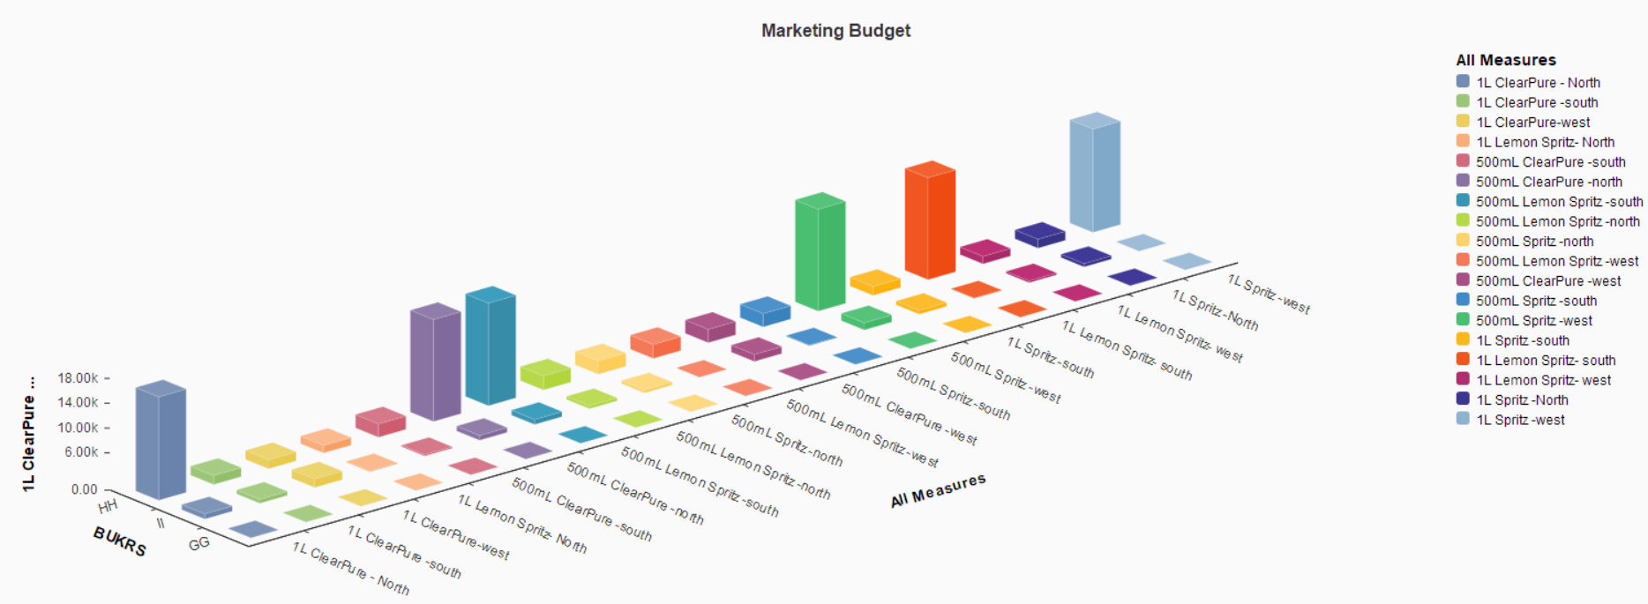
Marketing Strategy - Round 1
Large advertising budget
Low price Strategy
High volume sale strategy

Slide 12
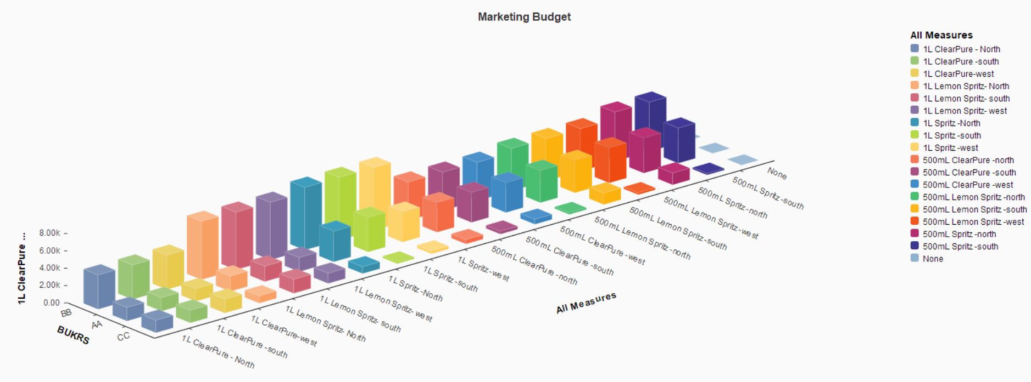
Marketing Strategy - Round 2
Lower advertising budget
Modify advertising depending on sale price
Modify advertising depending on sale volume
Modify advertising depending on product inventory

Slide 13
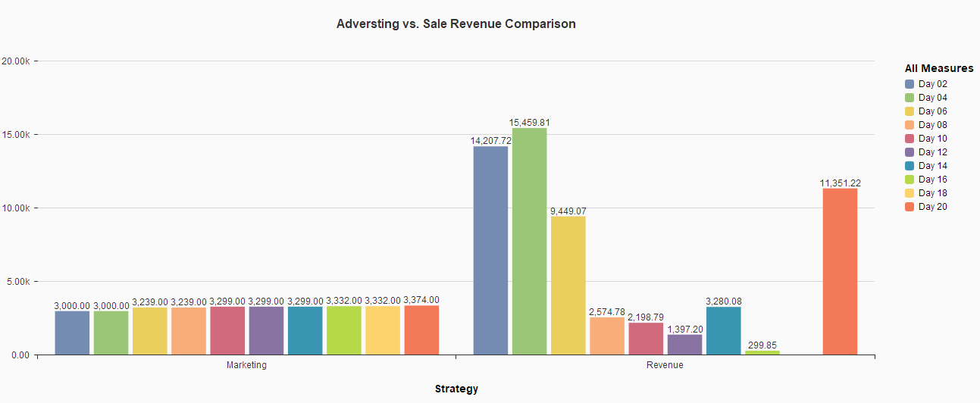
Marketing Analysis
Steady Advertising
Revenue Fluctuation

Slide 14
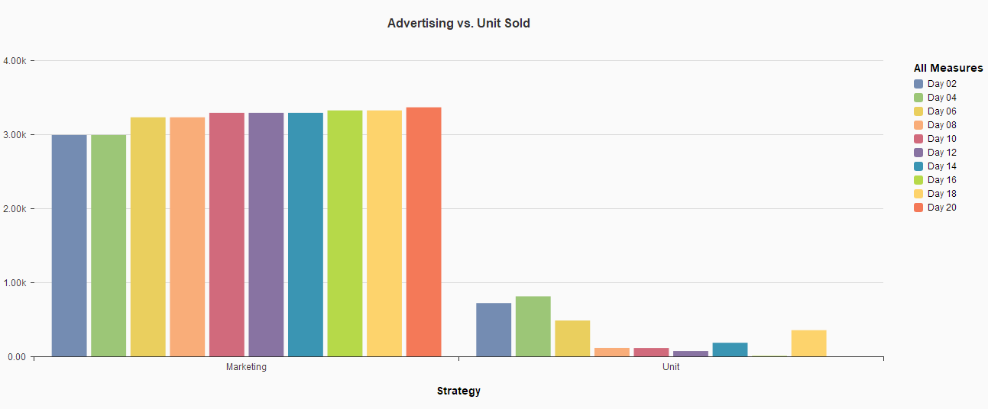
Marketing Analysis
Steady Advertising
Sold out Inventory

Slide 15




Software Tools & Technical Skills
ERP Platform & Business Process
SQL Queries and Odata Link
Extract .accdb File
Transform with Microsoft Access
Loading Data to Analytic Software
Visualizing using SAP Predictive Analytics

Slide 16



How Company BB Collaborated
During the ERP Sim:
Zoom:
Breakout rooms
Screenshare
Data Analysis, Presentation, Final Report:
Google Drive:
Docs, Slides
Comments
Phone:
Call
Text

Slide 17
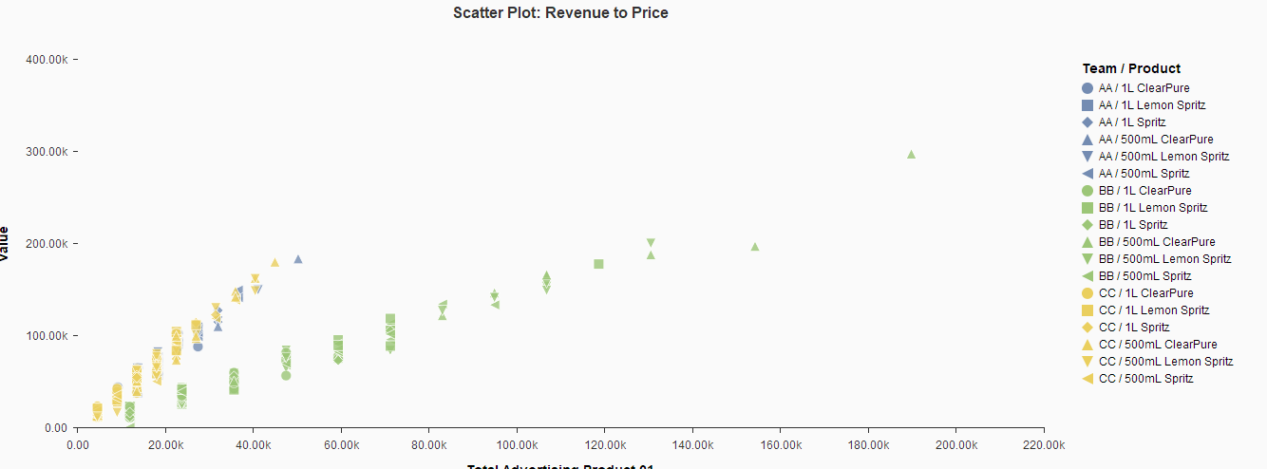
CEO Analysis
Market Driven
Proactive
-Price
-Marketing
-Inventory
Notes:
Taya

Slide 18
Company Valuations
Company Valuation = (current profit / number of rounds played) * 12(market risk rate + company risk rate)
= (522,598 / 2) *12(7+3)= (261,299)*(120)= $31,355,880

Slide 19
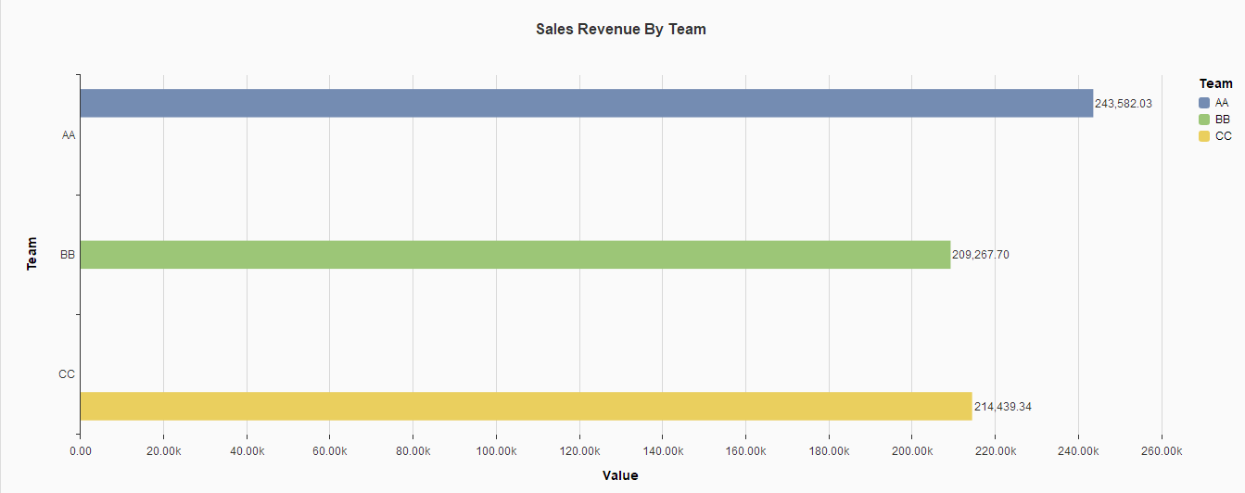
SALES REVENUE BY COMPANY
Team AA had the highest sales revenue of $243,583.03. Team BB had the lowest sales revenue of $209,267.00.

Slide 20
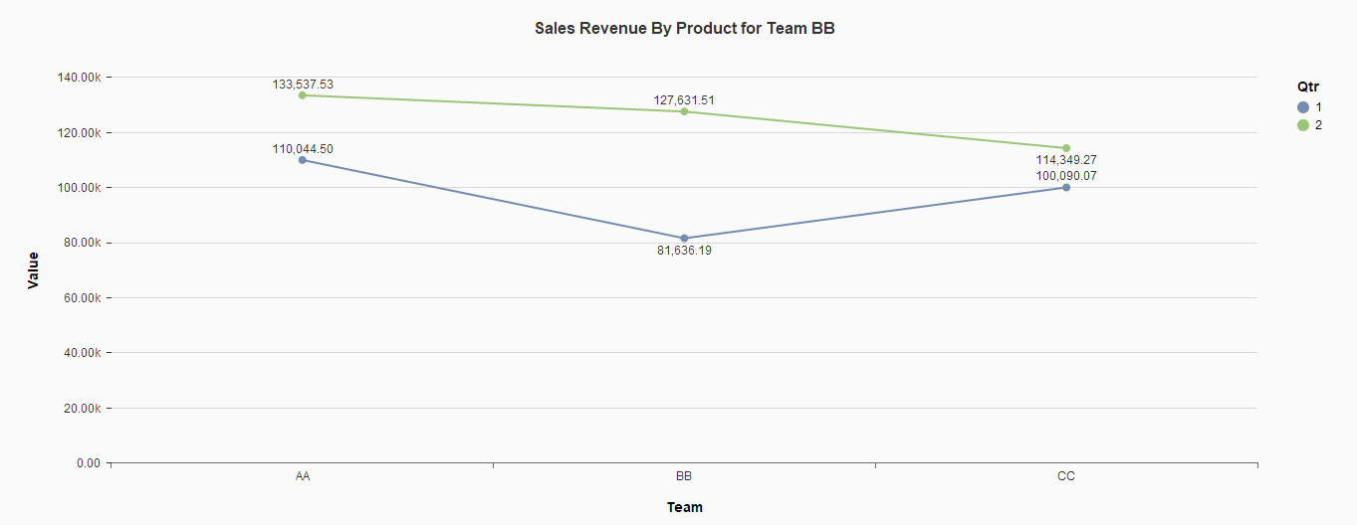
SALES REVENUE TRENDS BY TEAM PER QUARTER
Quarter 01:
Team AA: $133,537.55
Team BB: $127,631.51
Team CC: $114,349.27
Quarter 02:
Team AA: $110,044.50
Team CC: $100,090.07
Team BB: $81,636.19

Slide 21
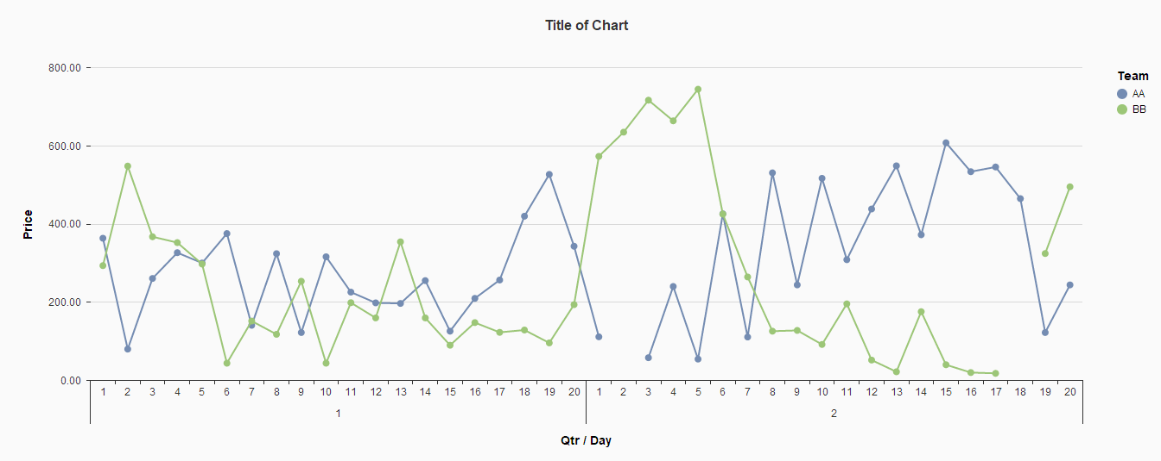
PRICE TRENDS BY TEAM AA, BB
Important Findings:
Team AA: The prices are fairly consistent (gradual increase/ decrease)
Team BB: The prices are very inconsistent, extreme changes in the price

Slide 22
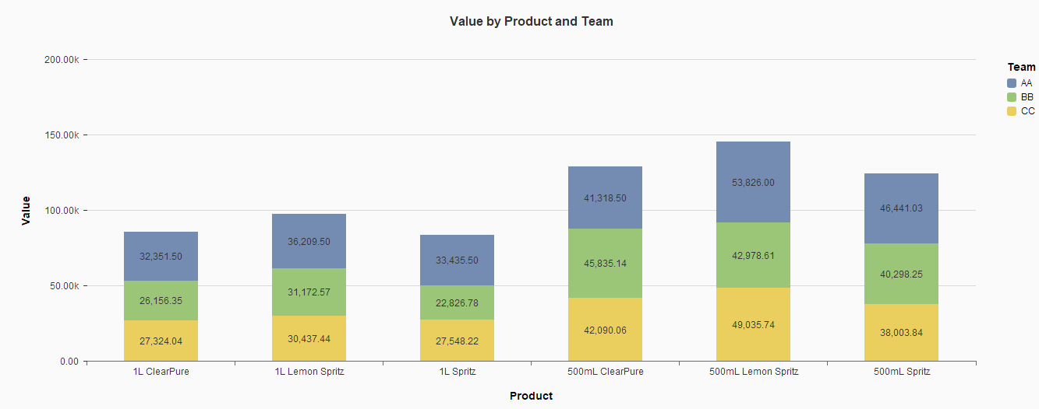
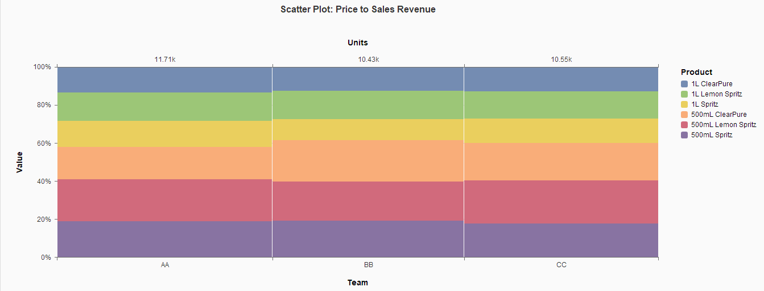
MARKET SHARE OF EACH TEAM BY PRODUCT
Dominant Company: Company AA
Dominant Product: 500mL Lemon Spritz
Most sold product of Team AA:

Slide 23
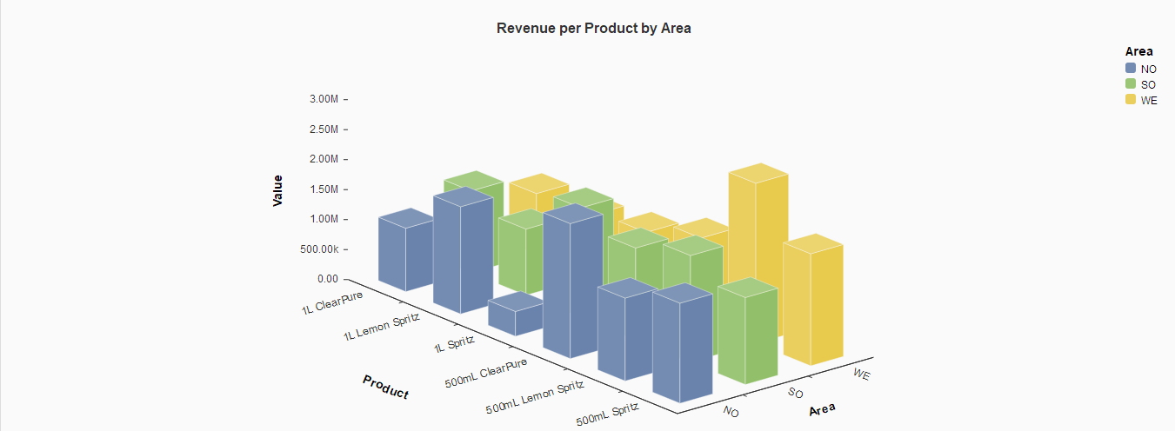
Regional Preference
North: 500mL ClearPure
South:1L Spritz
West: 500mL Lemon Spritz

Slide 24
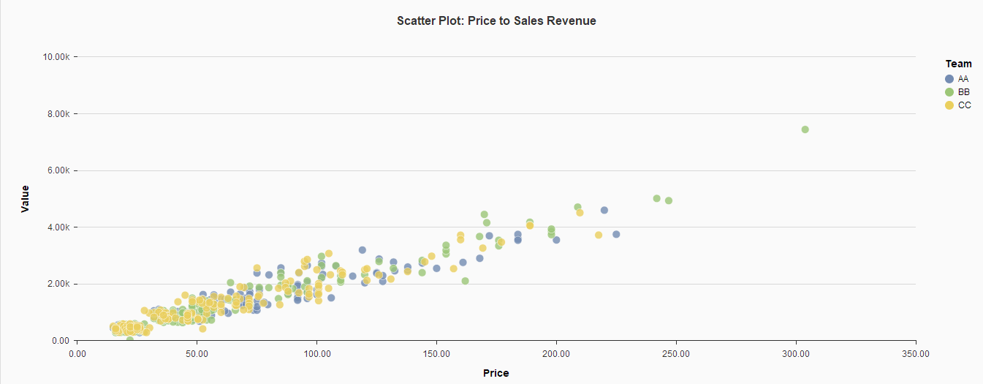
Scatter Plot: Price to Revenue

Slide 25
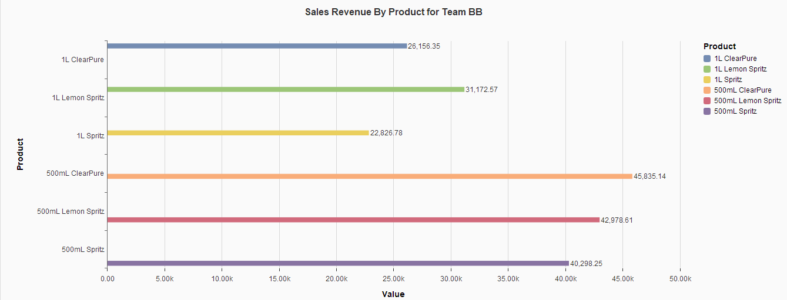
SALES REVENUE BY PRODUCT FOR TEAM BB
500mL ClearPure generated the most sales revenue of $45,834.18. 1L Spitz generated the least sales revenue of $22,826.78.

Slide 26
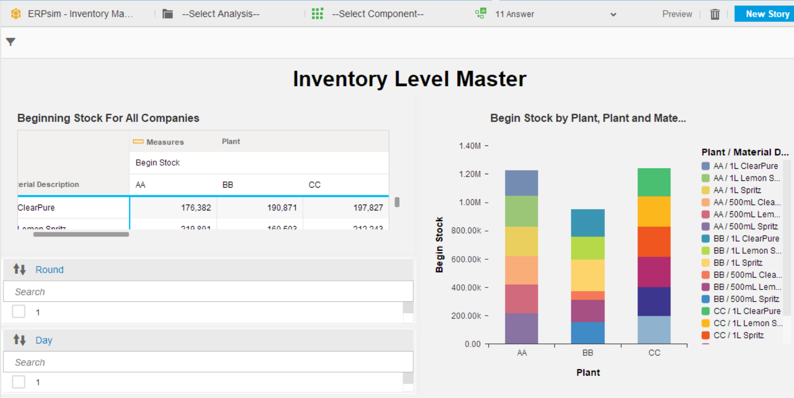
MATERIALS MANAGER/PURCHASE ORDER Analysis
Notes:
This is a snapshot of an interactive chart or dashboard using SAP Predictive Analytics
Top Left: Table
Bottom Leftt: Check boxes showing Time
Right:Stacked Bar Chart

Slide 27
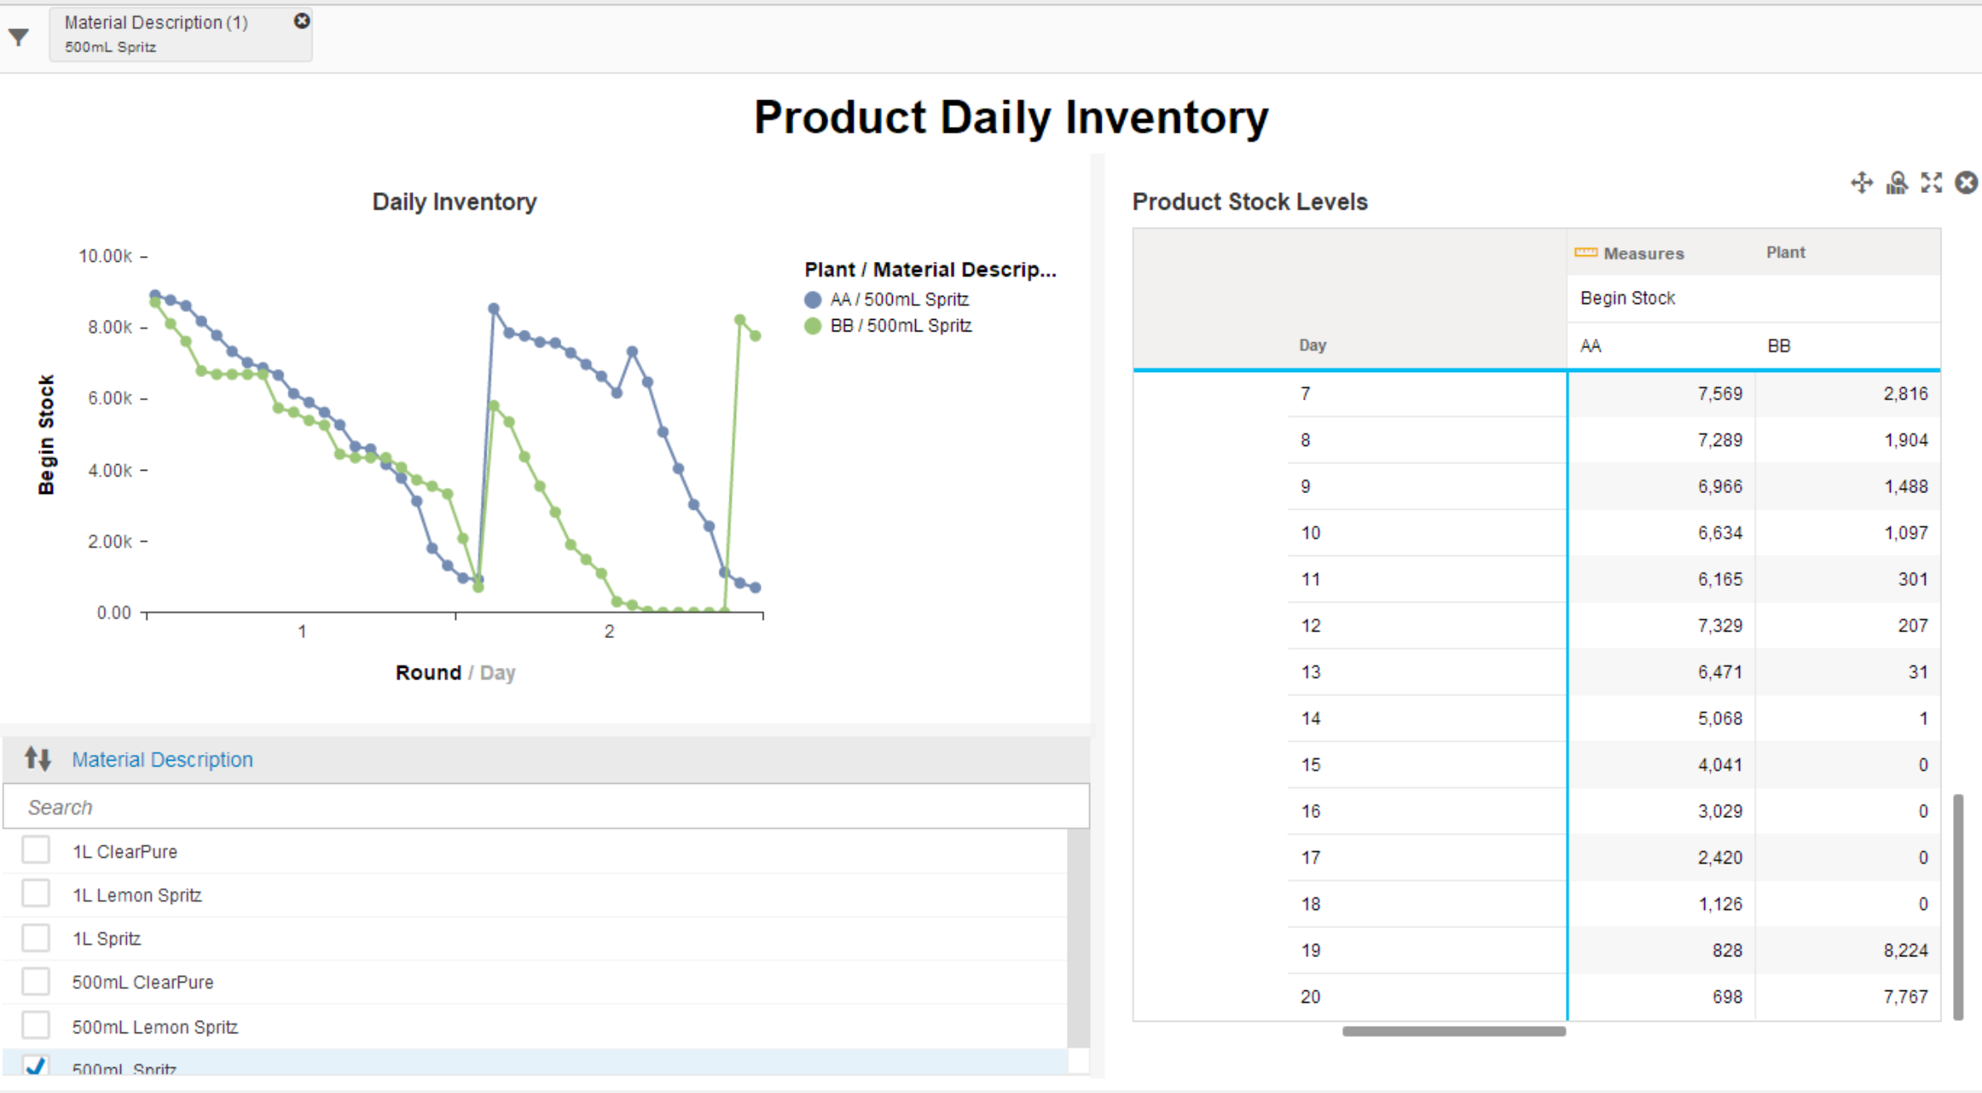
Cont.

Slide 28
Where can we Improve?
Inventory Levels and Procurement: The delay of stock cause low inventory which cause slow sales. Having enough inventory on hand and not waiting for inventory to get too low to start reordering process.
Stabilize the price of products: The prices were too volatile. Set prices low then gradually increase price to keep preserver inventory.
Competitive Marketing Budget - Lower advertising comparatively & less frequently modify advertising price
Better Strategy- Maintain competitive pricing without increasing the chance of a stock out

Slide 29
Conclusion--Lesson Learned
(PO Manager) The ERPsim has allowed for the exploration and understanding of how ERP systems run in SAP and how the procurement process is managed within the system.
(Sales Manager) The ERPsim allowed me to develop a sales strategy for a fictional company. I now better understand the amount of data generated from business transaction.
(Marketing Manager) Follow market strategy & concrete advertising budget
(CEO) ERPsim was a limited perspective of the water bottle market but it introduced the intersection between efficient ERP technology and business strategy. The future of business is heavily dependent on timely analytics.

Slide 30

Questions & Answers

